Slide 1
API Concepts
Hy-Tech Club: Web 103
Notes:
Let’s talk about APIs at a high level – we won’t get into any code, but try to understand all these concepts.

Slide 2
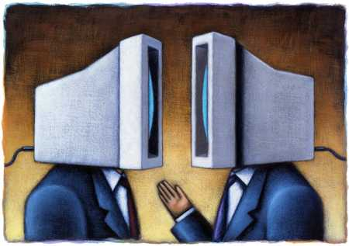
What is an API?
Application
Programming
Interface
Notes:
Does anyone already know what an API is?
API stands for Application Programming Interface. An API is basically a way for one piece of software to talk to another piece of software. An API will have specific methods for sending and receiving data.

Slide 3

Analogy: Ordering from a Menu
Menu
risotto …… 19
lobster …… 22
ratatouille …… 27
pizza …… 15
steak …… 32
How would you order from this restaurant?
Place Order 📞 → Receive Food 🍚
Interface
Instructions for communication
Defined list of dishes from which to choose
Stuff happens behind the scenes
APIs are just like that… but requests are sent through code!
Notes:
To try to understand further, let’s consider this analogy: ordering from a menu.
Here’s a menu as an example – there are some different options, and all of them have different prices.
Can anyone tell me – how would you order from this restaurant?
The menu itself makes it easy to know what you can do! You know how to place an order, and you know that when that order is fulfilled, you will receive your delicious risotto. Let’s break this down a bit.
The menu and ordering system comprise an interface: basically, there are some specific instructions for communication. You know the rules, and you follow them.
The menu has a clearly defined list of dishes. You can’t order anything at all – you need to conform to the standards set by the restaurant.
After you order, you don’t need to know what happens in the kitchen! All you need to know is that you get your food.
And APIs are kind of like that, but instead of placing your order through the phone, you would use code to do it for you. It’s kind of like getting your mom to order pizza.

Slide 4






What Can You Do with an API?
Web API
Get Menus
Manage Accounts
Place Orders
HTTP
Notes:
But ordering pizza isn’t all an API can do. In fact, there are a ton of APIs out there that let you write code to talk to a bunch of different services.
You can write code to post a TikTok, view Instagram pictures, play a song on Spotify, get a listing of houses from Zillow, post messages to Discord…
Many of these require an API key, and some cost money, but there are so many out there, including…
GrubHub! Sticking with the food theme, GrubHub has what’s called a Web API – that just means the communication happens through the world wide web.
With the API, you can do things like get menus for restaurants, manage your account information, even place orders, all by running some code!
Web APIs are made possible by a thing called HTTP.

Slide 5
HTTP
The Magic of Cyberspace
Notes:
Ah yes, HTTP – the magic of cyberspace.

Slide 6

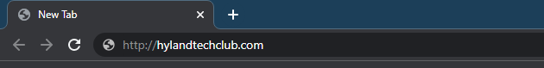
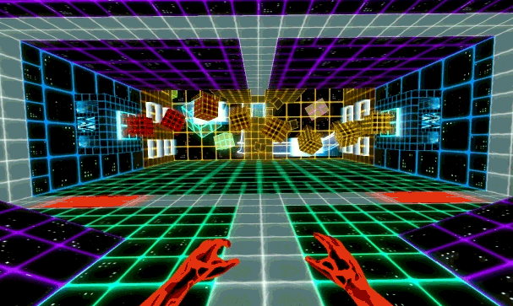
What is ?
HTTP
S
HyperText Transfer Protocol
The channel through which World Wide Web applications communicate
A set of rules that allow software programs to send and receive data through the internet
The thing you put at the beginning of URLs to say “look online for this”
Notes:
Where have you seen HTTP?
It’s in front of every URL you type! Does anyone know what it actually means?
HTTP stands for HyperText Transfer Protocol.
Essentially, it’s a way to send messages through cyberspace. HTTP creates a channel through which all web apps communicate. It sets up a specific set of rules (like a menu) that let software programs send and receive data. It’s also the thing you put at the front of URLs when you want your browser to know to look on the internet! If you’re surfing the web, HTTP is the wave, dude.
Note: HTTPS is HTTP but secure – so we will use HTTPS

Slide 7
Two Sides of HTTP
Requests
Responses
Asking for something
From
Client (e.g., JavaScript)
To
Server (e.g., GrubHub)
Returning something
From
Server (e.g., GrubHub)
To
Client (e.g., JavaScript)
Notes:
Let’s get a little deeper. There are two main things to remember – the two sides of HTTP.
On one hand, you have requests. On the other, you have responses.
A request is asking for something. A response is getting something back. Hopefully this isn’t too out there yet.
When you make a request, it comes from a client, and goes to a server. For example, some JavaScript code you write might send a request to GrubHub, trying to get a restaurant’s address.
On the flipside, when you get a response, it comes from the server, and returns to the client. So, GrubHub sends you the restaurant’s address.

Slide 8


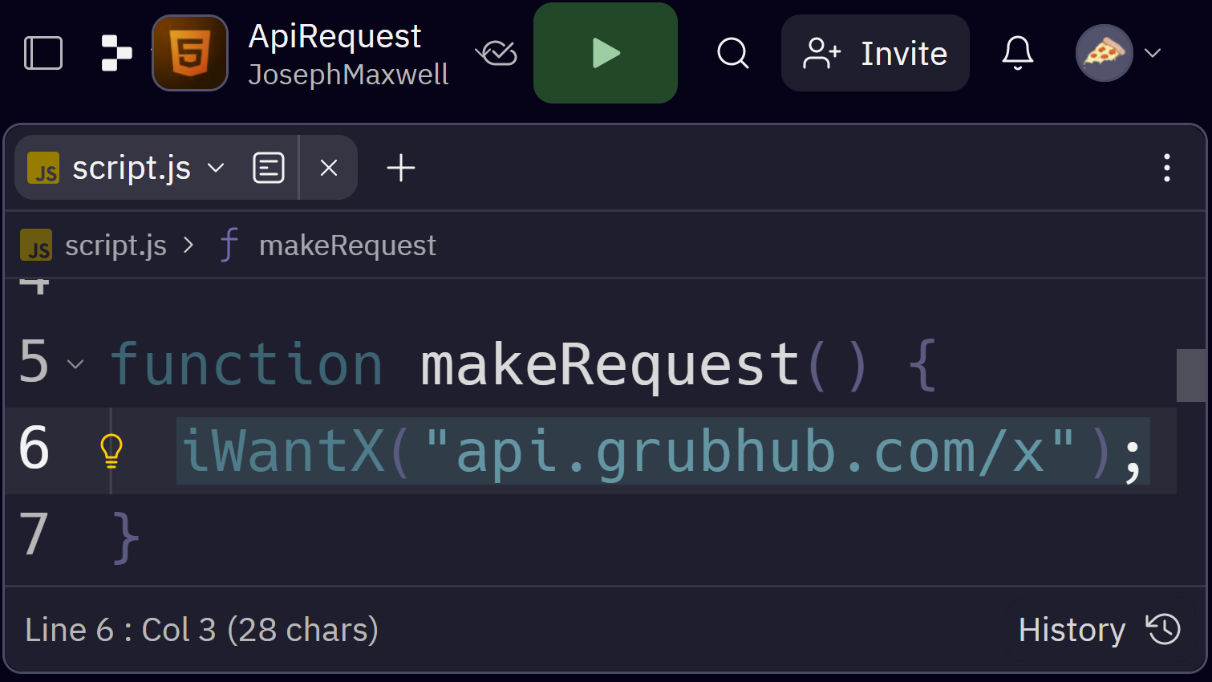
Client-Server Architecture
REQUEST
I want X
api.grubhub.com
CLIENT
RESPONSE
SERVER
Here is X
Notes:
These client and server things are very important, and make up the architecture for almost all web applications.
The client could be something like JavaScript code – something you would write in Replit. The server would be some machine somewhere, hosted at a certain URL, like api.grubhub.com.
The client makes a request, saying “I want X” – for example, I want a picture of a cheeseburger.
The server sends back a response, saying “Here is X” – for example here is a picture of a cheeseburger. The server doesn’t always give the client what they want – the client has to make sure to have the right authorization and the right request format. Otherwise, there could be issues.

Slide 9
HTTP Requests: GET
Every time you type a URL into your browser and send it, that’s a GET request!
GET is an HTTP request method.
Other methods can modify data, like POST; it sends a new data object to the server.
GET Requests let clients get data & files.
Notes:
For the purposes of this course, the main type of request to know is a GET request.
Every time you type a URL into your browser and send it, that’s a GET request – so you’re already doing it!
GET is one example of a request method, but it’s not the only one!
You can also do different types of requests that modify data, such as a POST request – that one sends a new data object to the server. For example, if you were to send a tweet, that would be a POST request.
GET Requests only give data – they do not change anything. They let clients get data and files. But how can they specify what kind of data or files they want?

Slide 10
GET: URLs
Example: https://fda.gov/search
https://fda.gov/search?s=risotto&items_per_page=10
Query parameters are optional key-value pairs added to the end of a URL. The server uses this data to respond appropriately to the request.
?s=risotto&items_per_page=10
? Parameter Name = Parameter Value &
Notes:
GET requests use URLs to indicate what they want from the server. For example, this first one will go to fda.gov and load the search page.
But when you want to search for something, it might reload the page with a thing like this.
There’s something extra at the end here… anyone know what these things are called? Anyone recognize this stuff from anywhere?
These are query parameters! They are optional key-value pairs added to the end of the URL. The server uses this data to respond appropriately to the request.
Let’s break down this example. The specific order of the symbols is important – it’s a lot like creating variables in JavaScript.
Start with a question mark at the end of the base url
Then there’s the parameter name – in this case, it’s s
Then there’s an equals sign
Then the parameter value – in this case, it’s risotto
Then, there’s an ampersand, and more query parameters can come after that!
When working with query parameters, the symbols and parameter names and values all need to be exactly right – so pay attention!

Slide 11
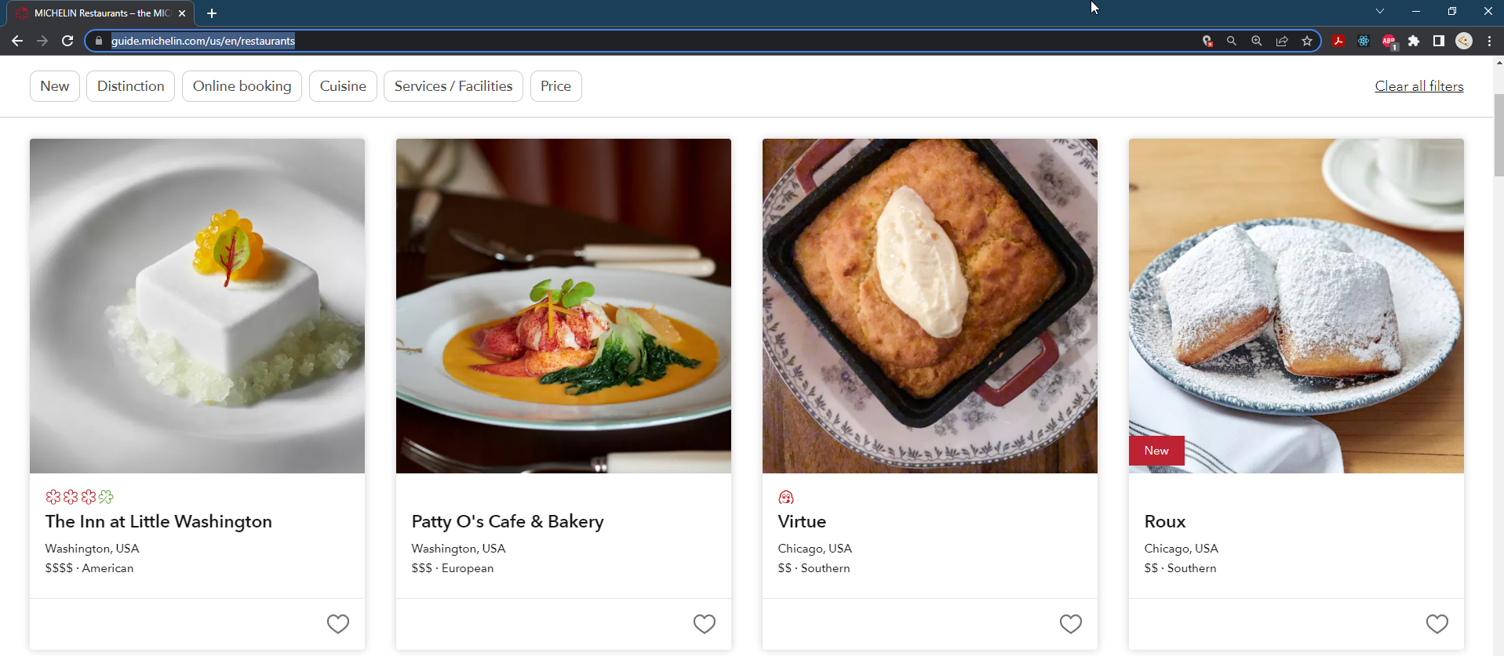
HTTP Responses: HTML Page
https://guide.michelin.com/us/en/restaurants
Notes:
Now once those requests are sent, there are a few different kinds of responses. The basic one, which you have already seen, is a full HTML page! For example, heading to the Michelin website’s list of restaurants will display this nice page with all the restaurants in a grid. But that’s not the only type of HTTP response!

Slide 12
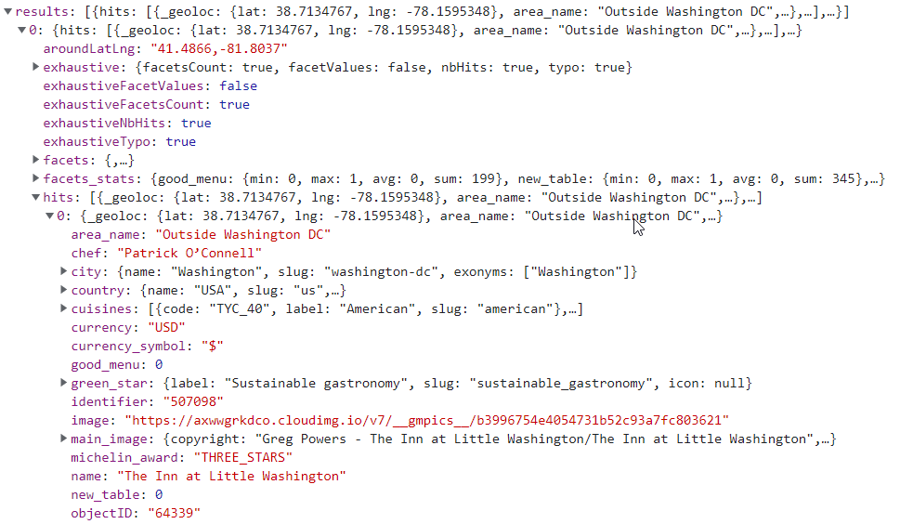

HTTP Responses: JSON
https://8nvhrd7onv-dsn.algolia.net/1/indexes/*/queries?x-algolia-agent=Algolia%20for%20JavaScript%20(4.14.2)%3B%20Browser%20(lite)%3B%20instantsearch.js%20(4.44.0)%3B%20JS%20Helper%20(3.10.0)&x-algolia-api-key=3222e669cf890dc73fa5f38241117ba5&x-algolia-application-id=8NVHRD7ONV
This data is all behind the scenes, powering the nice user experience
Notes:
HTTP Responses can also be data, like JSON!
Taking the same Michelin example, there is actually a hidden request that happens to pull all the data for a given search. This shows up as JSON.
All this data powers the user experience. The JavaScript code on the website takes this giant object, parses it, and makes it into something beautiful.
Kind of like a good chef takes ingredients and turns them into a beautiful dish. 😇

Slide 13
Network Connectivity
More Like NOTwork Connectivity 😔
Notes:
But it’s not always easy. This is the internet we’re talking about, and things can be… slow.

Slide 14

Internet Speed
Have you ever dealt with slow internet?
How do websites handle slow connection speeds?
Notes:
Has anyone ever dealt with slow internet? The answer is likely: yes.
You might have had network connectivity problems in the past. But the pages of your websites are still there, waiting to connect… how do they handle it when your internet is slow?

Slide 15
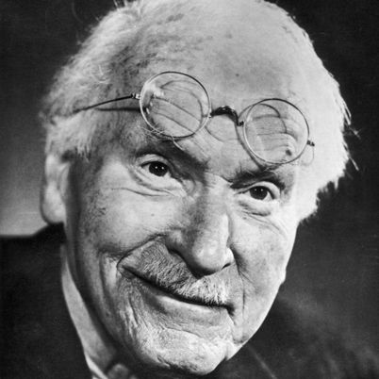
Synchronicity & Asynchronicity
Synchronicity is a concept first introduced by analytical psychologist Carl Jung "to describe circumstances that appear meaningfully related yet lack a causal connection."
This is completely irrelevant
Asynchronous programming is a technique that enables your program to start a potentially long-running task and still be able to be responsive to other events while that task runs, rather than having to wait until that task has finished.
Notes:
Well, timing is very important in software development, and in life. Any Carl Jung fans know what synchronicity is? Here’s the definition.
This is completely irrelevant, because we’re not talking about synchronicity… we’re talking about asynchronicity. Anyone know what asynchronous means? You may have done asynchronous learning in school, where you don’t have to be in a classroom at a certain time, but complete work at your own pace on your own time. Asynchronous programming is kind of like that!
It’s basically a way for a program to stay active while waiting for a long-running task to complete. One such long-running task might be – sending an API request! Servers can be slow, and locking down an entire page while waiting for a task to complete is generally a bad idea. So how is this possible????

Slide 16
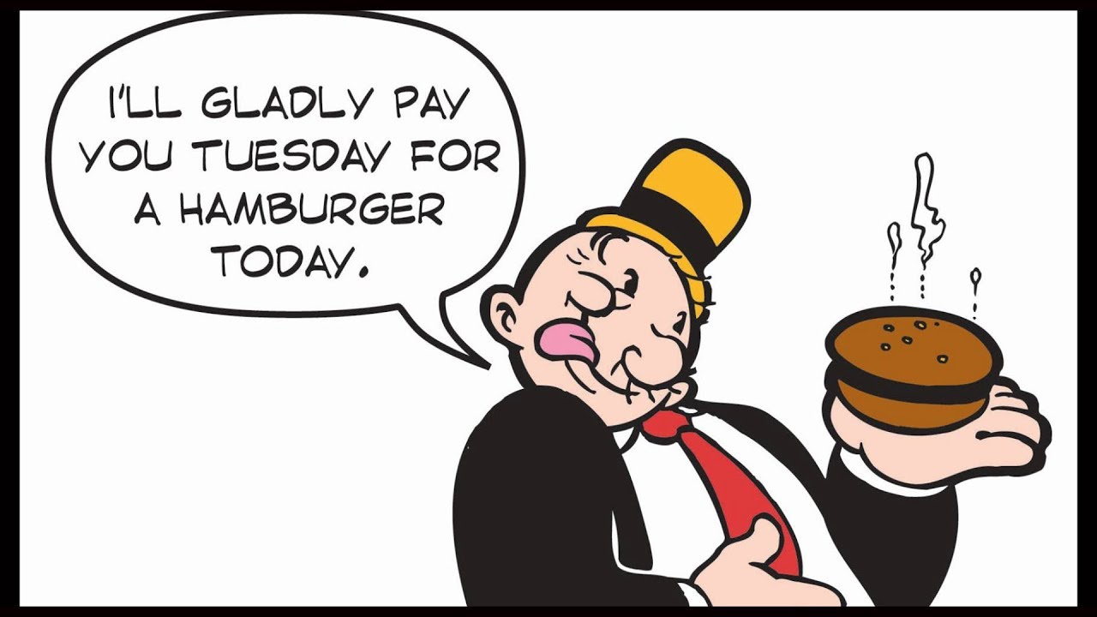
JavaScript Promises
doSomething().then(url =>
fetch(url)
.then(res => res.json())
.then(data => {
listOfIngredients.push(data);
}).then(() => {
console.log(listOfIngredients);
});
Promises enable asynchronous programming in JavaScript.
A Promise is a weird type of object that has a weird syntax and is generally weird. Just try to remember...
Notes:
In life, there are these things called promises. Has anyone ever made a promise? What does it mean?
A promise is basically saying I am going to do this thing – and I’ll get back to you later.
In JavaScript, using a promise looks something like this.
Don’t understand what you’re seeing? That’s very normal! Promises are very very weird things with very weird syntax. They are weird, and using them is weird. They return very weird things and it’s weird.
For now, the important thing to remember is that promises enable asynchronous programming in JavaScript. And we need asynchronous programming to make requests to an API. Got it? Good!

Slide 17
HTTP Status Codes
https://http.cat/

Slide 18
THE END
Questions?
Notes:
I assume there are no questions.

